Slide 1
SYSTEMIC LUPUS ERYTHEMATOSUS
Dr. Ahmed Roshdy Al-Agamy
Lecturer of Rheumatology
Sohag University
2017

Slide 2
DEFINITION

Slide 3
Definition
Systemic lupus erythematosus (SLE) is a multisystem, autoimmune disease that is heterogeneous in its presentation and manifestations; it is almost universally characterized by the presence of circulating ANA.

Slide 4
EPIDEMIOLOGY

Slide 5
Epidemiology
SLE primarily affects young women with a peak incidence between the ages of 15 and 40 years, with a female to male ratio of 6 to 10:1.
In the very young and the older patients, the female to male ratio is closer to 2:1.
In the general population, SLE affects approximately one in 2000 individuals.

Slide 6
ETIOLOGY

Slide 7
Etiology
Though most cases of SLE appear sporadically, as is seen in other autoimmune conditions, there are genetic (heritable complement deficiency, HLA alleles, and PTPN22) and environmental (infection, sex hormones) factors that impact disease expression.
There is a higher incidence of disease among first-degree relatives, and in monozygotic twins disease concordance is 25–50%.
Of note, first-degree relatives of patients with SLE also appear to be at a higher risk for developing other autoimmune diseases including idiopathic thrombocytopenic purpura and autoimmune thyroiditis, suggesting shared genetic and/or environmental risk factors among these different conditions.

Slide 8
PATHOGENESIS

Slide 9
Pathogenesis
SLE is characterized by a loss of tolerance to self antigen and the expression of autoantibody (classically ANA).
Inflammatory lesions in SLE are due to autoantibody binding to self antigen, the formation and deposition of immune complexes, complement activation, and the expression of proinflammatory cytokines (typically Th-2 phenotype, interleukin [IL]-4, IL-10).

Slide 10
CLINICAL HISTORY AND PHYSICAL EXAMINATION

Slide 11
Clinical history and physical examination
SLE is manifested by different signs and symptoms leading to substantial clinical heterogeneity.
Virtually every organ system can be affected in SLE, evident in the American College of Rheumatology (ACR) disease classification criteria (Table 38).
Clinical signs and symptoms by system are summarized in Table 39

Slide 12
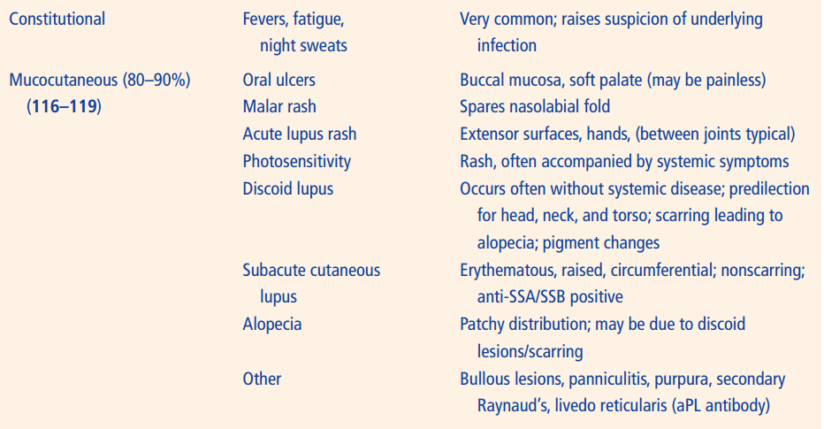

Slide 13
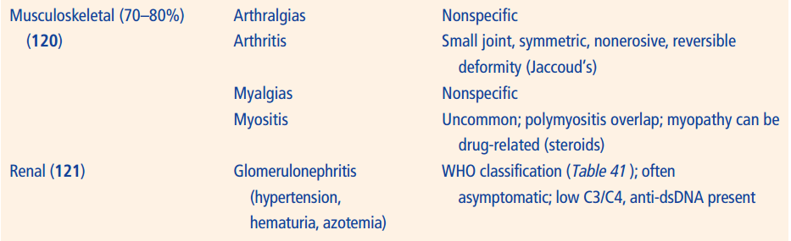

Slide 14
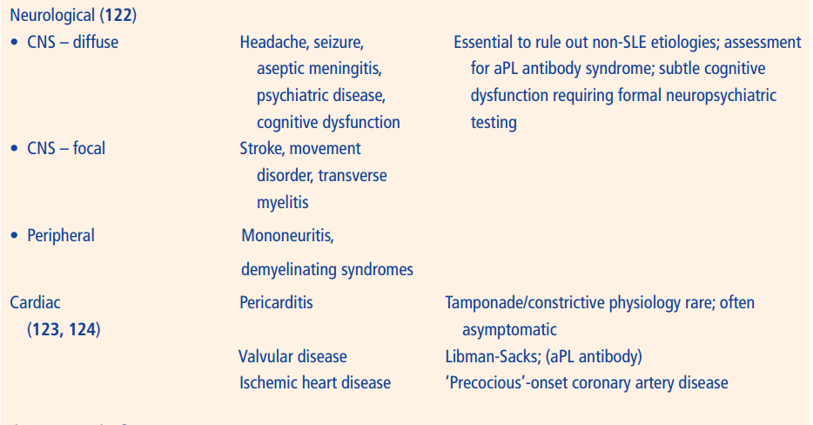

Slide 15
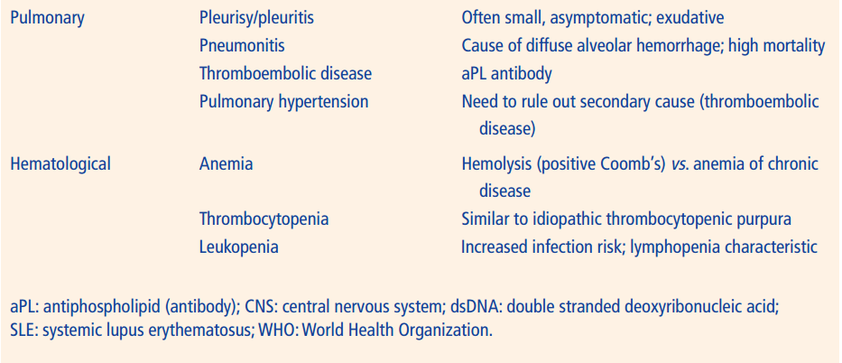

Slide 16
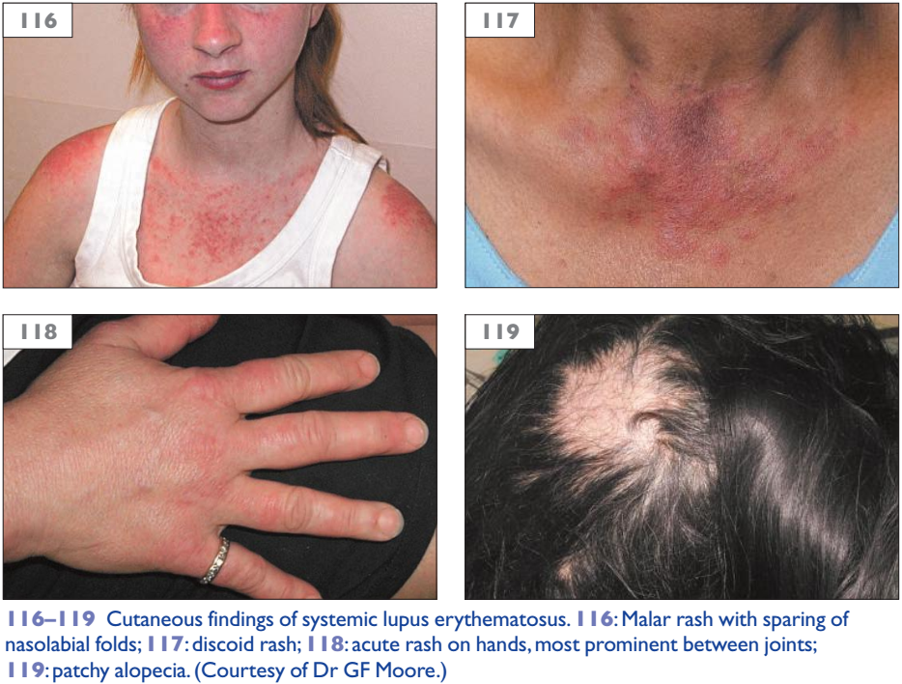

Slide 17
DIFFERENTIAL DIAGNOSIS

Slide 18
Differential diagnosis
The differential diagnosis for SLE is broad and is guided by the organ involvement and clinical presentation.
In the hospitalized, acutely ill patient, infection and malignancy must be considered.
Additionally, vasculitis and other CTDs can be confused with SLE.
The key to a successful diagnosis is a complete history and physical examination coupled with appropriately targeted laboratory testing.
Inflammatory arthritis of SLE may closely resemble that of RA, further complicated by the fact that 20–30% of patients with SLE are RF-positive. Likewise, CNS lupus may closely mimic multiple sclerosis.
The diagnosis of SLE is based on clinical grounds as there is no single diagnostic test; diagnosis may be guided by disease classification criteria (Table 38).

Slide 19
CLASSIFICATION CRITERIA

Slide 20
The OLD classification criteria (1997 revised ACR criteria)
Table 38 The 1997 Revised American College of Rheumatology systemic lupus erythematosus classification criteria
Malar rash
Discoid rash
Photosensitivity
Oral ulcers
Arthritis which is nonerosive involving two or more peripheral joints
Serositis to include pleuritis or pericarditis
Renal disorder to include persistent proteinuria (>500 mg per day or >3+ if quantification is not completed) or cellular casts (red cell, hemoglobin, granular, tubular, or mixed)
Neurological disorders to include seizures or psychosis
Hematological disorders to include hemolytic anemia, or leukopenia (<4000/mm³ total), or lymphopenia (<1500/mm³ on two or more occasions), or thrombocytopenia (<100 000/mm³ in the absence of offending drugs)
Immunological disorders to include anti-dsDNA antibody, or anti-Smith antibody, or positive findings of antiphospholipid antibodies (based on an abnormal serum level of IgG or IgM anticardiolipin antibodies or a positive lupus anticoagulant, or a false-positive serological test for syphilis)
ANA positivity by immunofluorescence or equivalent assay at any point in time, in the absence of drugs known to be associated with drug-induced lupus
SLE diagnosis requires the presence of at least four criteria; criteria intended to ensure uniform patient populations in clinical trials; criteria need not be seen simultaneously and are often observed additively.
ANA: antinuclear antibody; dsDNA: double stranded deoxyribonucleic acid; Ig: immunoglobulin.

Slide 21
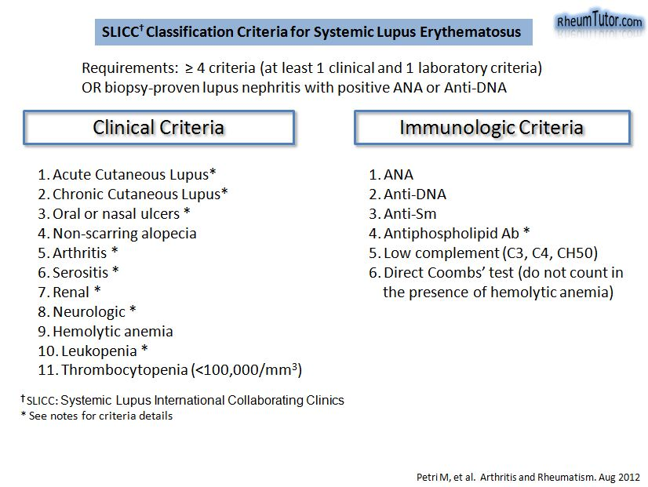
The NEW classification criteria (2012 SLICC criteria)

Slide 22
INVESTIGATIONS

Slide 23
Investigations
ANA is nonspecific but highly sensitive (>95% with indirect immunofluorescence); newer technologies may lack sensitivity.
Other autoantibodies (Table 40); antibody to extractable nuclear antigens (ENA) is used to evaluate ANA specificity.
CBC is essential in ruling out hematological involvement, cytopenias; lymphopenia is characteristic of SLE; thrombocytopenia is usually asymptomatic; anemia of chronic disease is common (80%).

Slide 24
Investigations
Creatinine and urinalysis to evaluate for renal involvement.
Complement proteins (C3 and C4 components) are often low with lupus nephritis but may normalize with disease control.
Kidney biopsy often guides treatment of nephritis; high levels of chronicity suggest poorly responsive disease.
Other tests (imaging, lumbar puncture, microbiology, other tissue biopsies) are guided by the clinical presentation and evidence of end-organ disease.

Slide 25
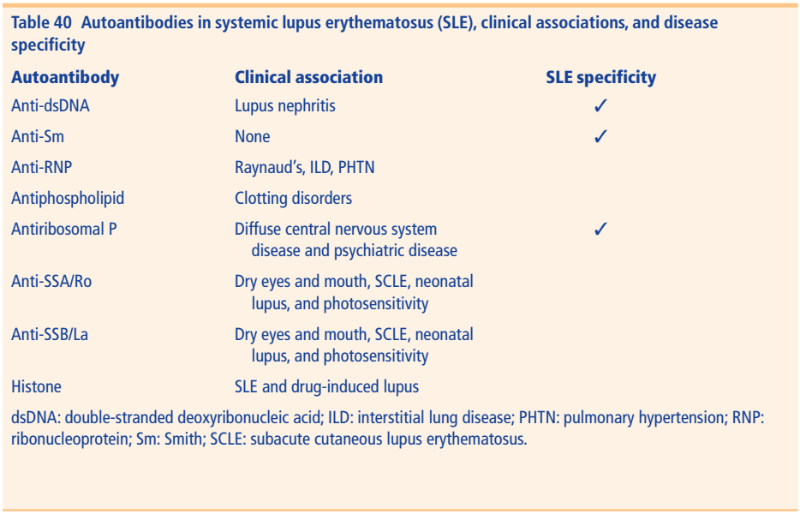

Slide 26
Histology
Involved tissues, such as the pleura or synovium, may display nonspecific changes of chronic inflammation.
Kidney specimens are perhaps the most commonly obtained and show the best characterized findings of SLE, and are used in the World Health Organization (WHO) classification for lupus nephritis (Table 41).

Slide 27
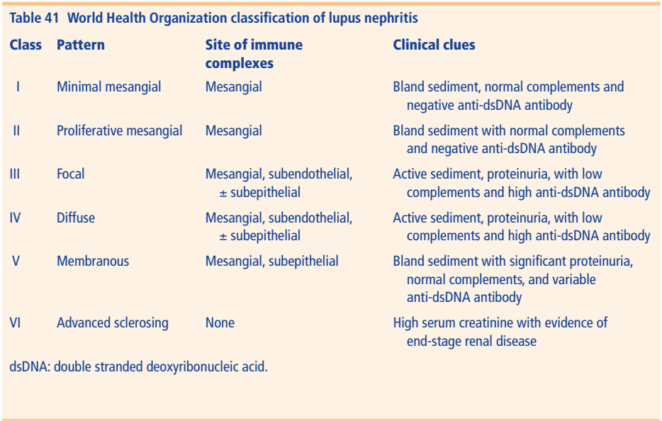

Slide 28
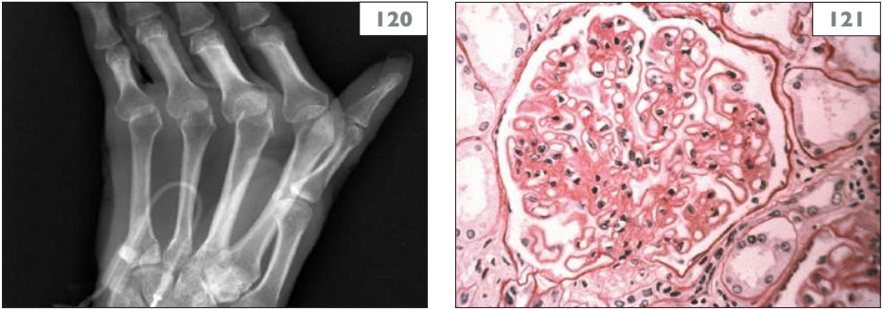
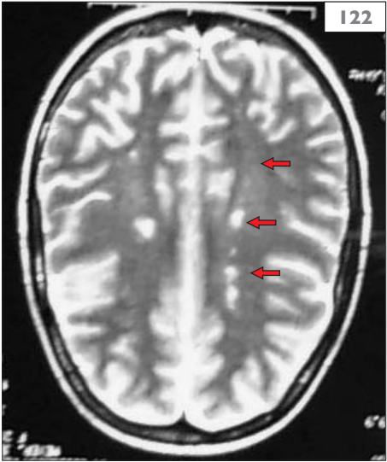
120–122: Systemic lupus erythematosus (SLE). 120: Hand radiograph in patient with SLE arthropathy; marked deformities that mimic those of rheumatoid arthritis (RA) including ulnar drift of the metacarpophalangeal joints; in contrast to RA, these deformities are reducible in SLE (Jaccoud’s arthropathy); note the absence of periarticular erosions.
121: renal histology showing changes of diffuse membranous glomerulonephropathy (WHO Class V).
122: brain MRI showing diffuse white matter changes in a patient with systemic lupus erythematosus presenting with acute mental status changes.

Slide 29
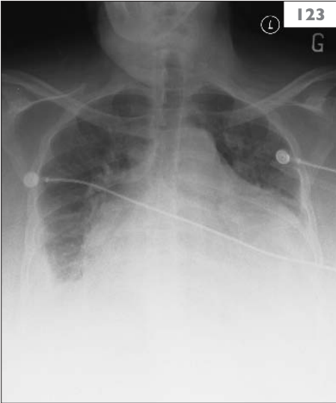
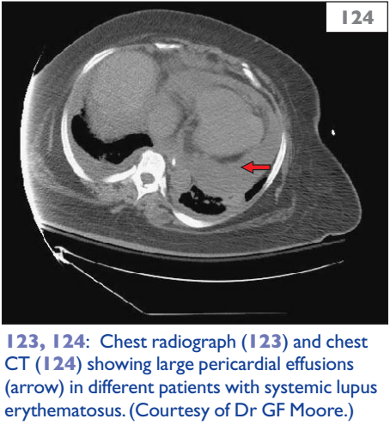

Slide 30
TREATMENT

Slide 31
Treatment
The successful management of SLE requires a comprehensive and multidisciplinary approach.
Integral to management is patient education, photoprotection, appropriate immunizations, and the identification and treatment of cardiovascular risk factors.
The management of ‘mild’ or nonmajor organ involvement includes NSAIDs, antimalarials, and glucocorticoids (GCs) (often in low-dose) most commonly.
NSAIDs are effective for musculoskeletal complaints; caution must be used with renal involvement.
GCs (prednisone or medrol) are common ‘bridge’ therapy; lower doses are often adequate for musculoskeletal complaints, higher doses (1.0–1.5 mg/kg/day of prednisone equivalent) are reserved for organ- or life-threatening SLE; adverse effects are common and are dose-related.
Antimalarials (typically Hydroxychloroquine; HCQ) are widely used for the musculoskeletal, cutaneous, and constitutional symptoms; they may reduce flare frequency and improve overall survival but have slow onset of action. Retinal toxicity is rare (routine ophthalmologic evaluation is required). Antimalarials should be given to all SLE cases unless contra-indicated.

Slide 32
Treatment
Immunomodulating, immunosuppressive, or cytotoxic drugs are often needed for moderate to severe lupus with major organ involvement:
Azathioprine (AZA) is a purine analog, and inhibits nucleic acid synthesis; it is an oral therapy, at a dose of 1–2 mg/kg per day; severe drug–drug interaction with allopurinol occurs; side-effects include GIand myelosuppression (CBC monitoring is essential).
Cyclophosphamide (CTX) is an alkylating agent given as daily oral or intermittent (monthly) intravenous therapy; it requires close clinical and laboratory surveillance.
Mycophenolate mofetil (MMF) has an important role in lupus nephritis.
Other immunomodulating agents that work through B cell depletion (e.g. rituximab) and other agents targeting lymphocyte expression/ function are under active investigation.

Slide 33
PROGNOSIS

Slide 34
Prognosis
There is a bimodal mortality pattern in SLE showing that early mortality is associated with disease activity and infection and late mortality associated with atherosclerotic complications.
Factors associated with higher mortality include lower socioeconomic status, age older than 50 years at the time of diagnosis, male sex, and low complements at the time of diagnosis.
Morbidity from treatment or disease is not easy to discern.
Infections, coronary artery disease, and osteonecrosis are common sources of morbidity.

Slide 35

ANY QUESTIONS?
Dr. Ahmed Roshdy Al-Agamy
Mobile: 01115230730
WhatApp: 01092914019
ahmed_radwan@med.sohag.edu.eg
Facebook: Ahmed Roshdy Agamy

